Slide 1

AERODYNAMIC ANALYSIS OF RQ-2 FIXED WING UAVS IN CLOSE FORMATION FLIGHT
By
Joash M. Oendo
&
Naef A.A. Qasem

Slide 2

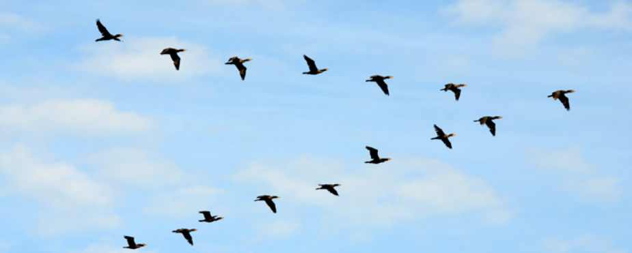
INTRODUCTION
The development and use of UAVs or drones have seen tremendous expansion over the last few decades.
The endurance and range are greatly desired.
Use of formation flight on aircrafts and UAVs;
increasing the capable range,
improving the efficiency of task execution.
Aircraft formation flying and wake surfing is inspired by migratory birds such as the Spruce geese, that fly in close formations, which increases their range by up to 71% for long solo flights

Slide 3
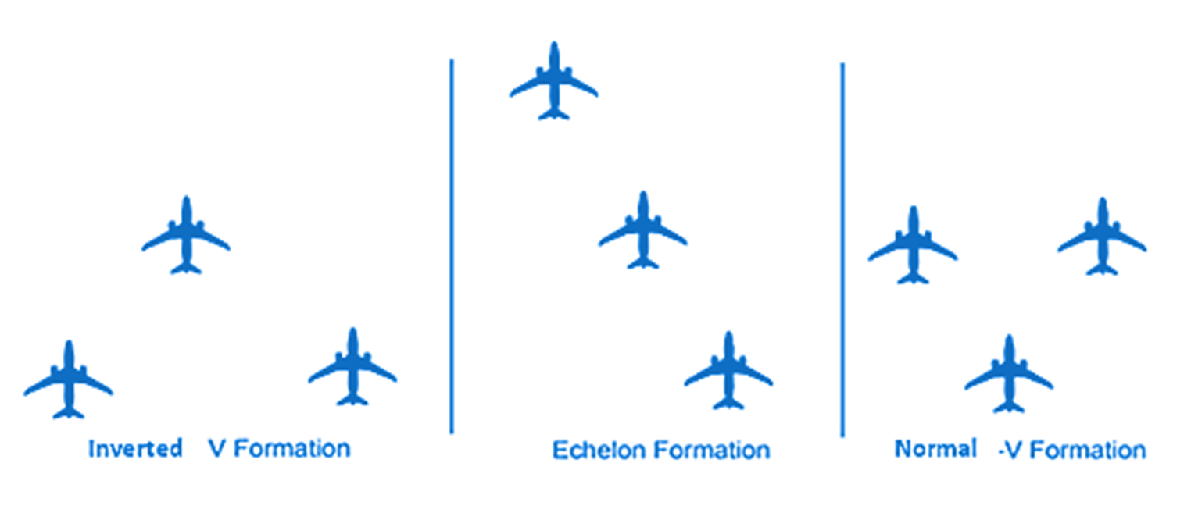
TYPES OF CLOSE FORMATION

Slide 4
ABOUT THE STUDY
The lead and follower aircrafts are maintained at optimal distance.
The wingtip vortices of the leading aircraft create a smooth current of rotating air behind.
The updraft air created, causes an increase in lift in the follower aircraft.
There is also relatively lower pressure gradient between the front and rear projected surfaces of the follower aircraft leading to a reduction in drag.

Slide 5
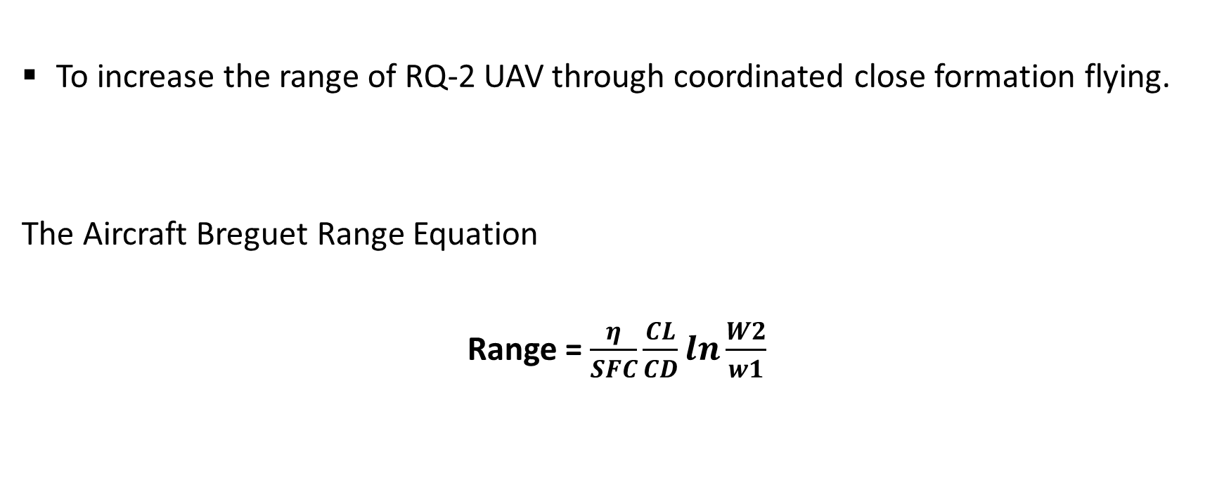
OBJECTIVE
To increase the range of RQ-2 UAV through coordinated close formation flying.
The Aircraft Breguet Range Equation
Range = $\frac{η}{SFC}\frac{CL}{CD}\ln{\frac{W2}{w1}}$

Slide 6
LITERETURE REVIEW
Formation flight in birds.
Related work of aircrafts flying in formations by Halaas et al. Airforce research lab and DARPA.
Zhang et al. conducted a detailed numerical analysis of the aerodynamic characteristics of 3 tailless UAVs in close formation flight.
In 2016 Yu et al conducted a validation test on autonomous formation flight.

Slide 7
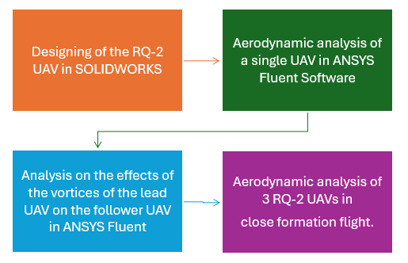
METHODOLOGY

Slide 8
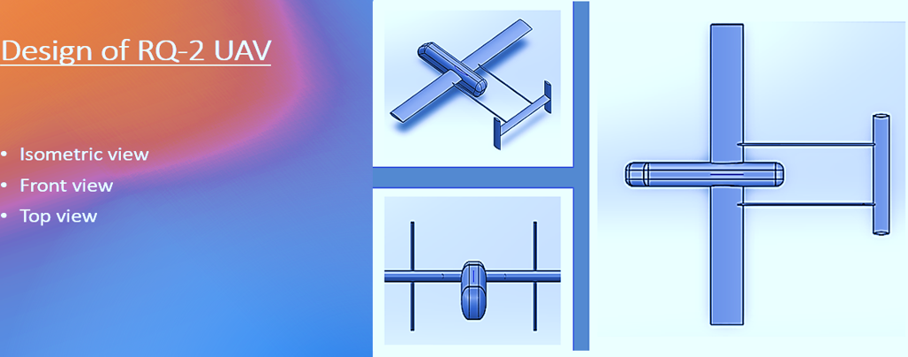

Slide 9
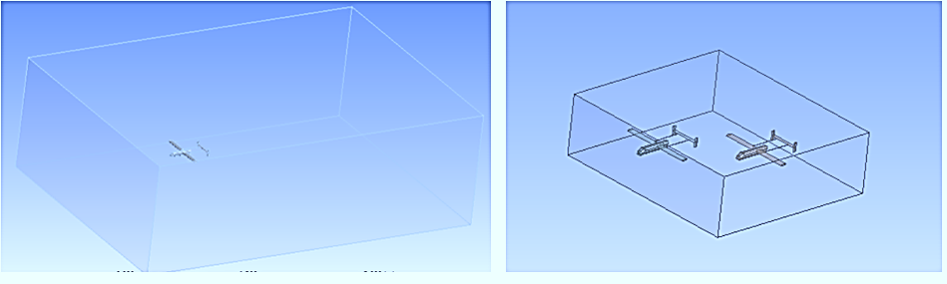
The Imported UAV model geometry and the inner flow domain enclosing the RQ-2 UAVs

Slide 10
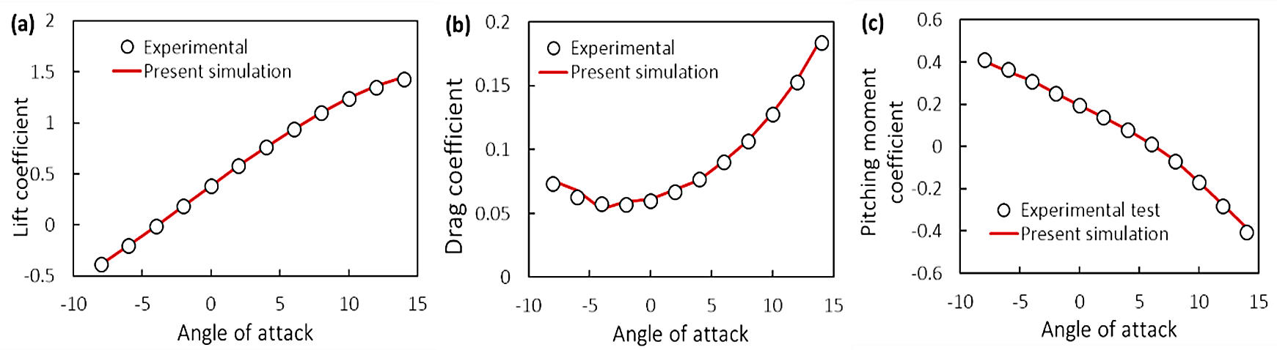
MODEL VALIDATION

Slide 11
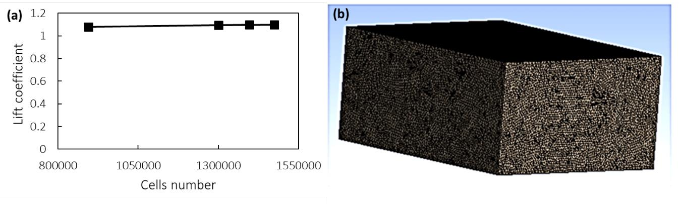
MESH INDEPENDENCE

Slide 12
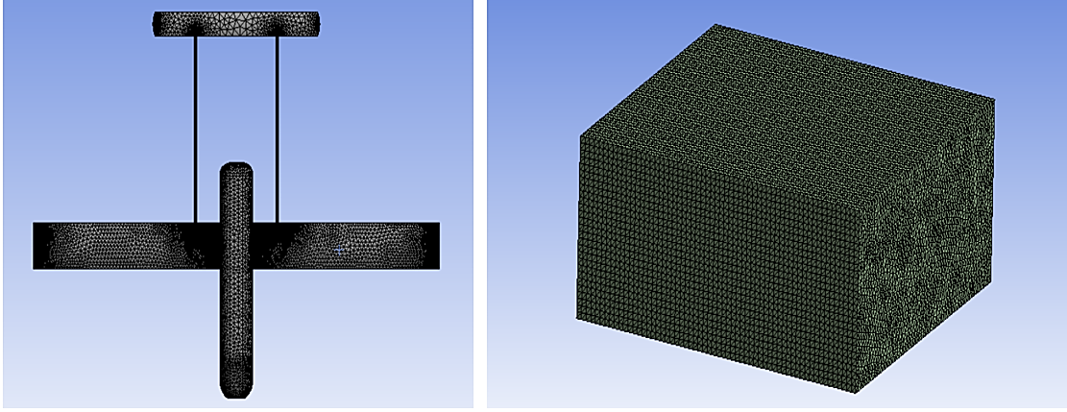
Refined mesh on the UAV surfaces and the flow domain mesh

Slide 13
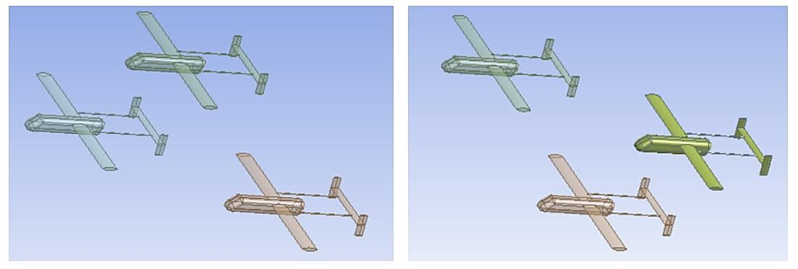
AERODYNAMIC ANALYSIS
Inverted and normal V pattern geometry

Slide 14
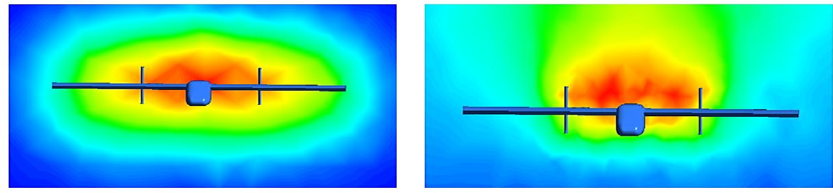
RESULTS AND DISCUSSION
Vorticity contours at 5m and 10m behind the leading UAV

Slide 15
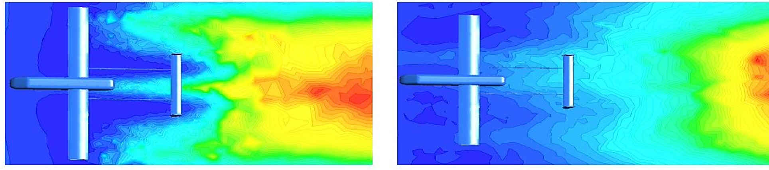
Vortex region at a horizontal plane at a vertical separation distance of -0.25m and -0.5m

Slide 16
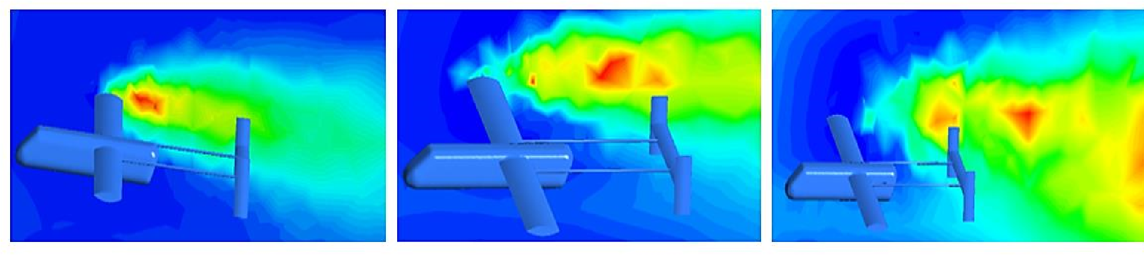
Plane at the wing tip 2.5m, 3m, and 3.75m lateral separation distance

Slide 17
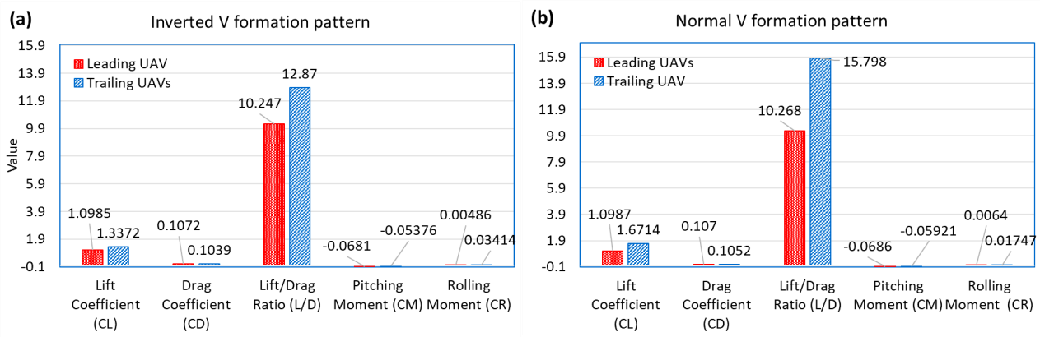
Aerodynamic characteristics of the UAVs in inverted and normal V pattern

Slide 18
CONCLUSION
There is notable increase in the lift coefficients in close formation flight, 25.6% in inverted V pattern and 52.4% in normal V pattern.
This translated to an average increase of 8.5 and 17.4% in the UAVs capable range.
The normal v formation pattern proved to better than the inverted v pattern, due to the reduced induced adverse rolling effect on the trailing UAV

Slide 19
REFERENCES
Lissaman P.B, Shollenberger C.A, “Formation flight of Birds.”- Science, vol. 160, 1970, pp. 1003-1005
Halaas D, Bieniawski S, Whitehead B, Blake W,” Formation Flight for Aerodynamic Benefit Simulation Development and Validation.”- AIAA SciTech Journal, vol. 52, 2014, pp. 13-17
Zhang D, Chen Y, Dong X, Liu Z, Zhou Y, “Numerical Aerodynamic Characteristics Analysis of Close Formation Flight.”- Mathematical Problems in Engineering, vol. 18, 2018, pp. 2-13.
Rice C, Gu Y, Chao H, Larrabee T, Gururajan S, Napolitano M, Mandal T, Rhudy M, "Autonomous Close Formation Flight Control with Fixed Wing and Quadrotor Test Beds", International Journal of Aerospace Engineering, vol. 16, 2016, pp. 1- 15.

Slide 20
THANK YOU!

